Slide 1
Making sure your dataset is ready for further analysis
AKA “Remove your blinders”
AKA “Due diligence”
AKA “Understanding your data”
AKA “QC”

Slide 2
Topics to cover today:
How much bacterial DNA did you have in your samples?
How much data did you generate?
How skewed is your data, and what is your LOD?
How much contamination do you have in your data?
How much technical confounding do you have in your data?

Slide 3
Topic #1: Microbial (bacterial) biomass
(How worried do I need to be about the other 4 topics in this lecture?)

Slide 4
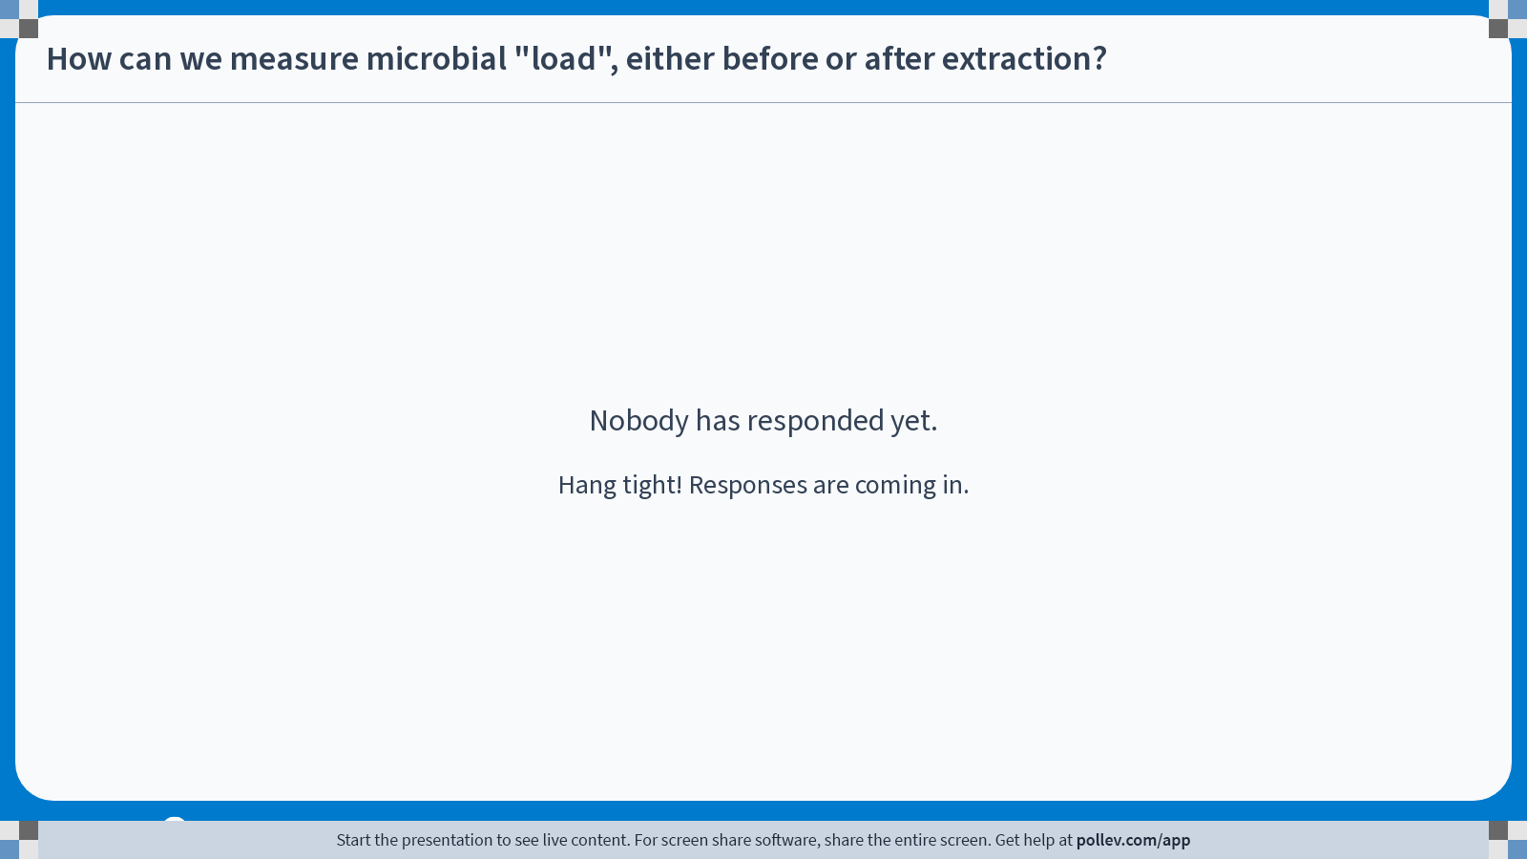
Notes:
Do not modify the notes in this section to avoid tampering with the Poll Everywhere activity. More info at polleverywhere.com/support How can we measure microbial "load", either before or after extraction?
https://www.polleverywhere.com/free_text_polls/tlq7kHGQFLwrS2IXVO7oC

Slide 5
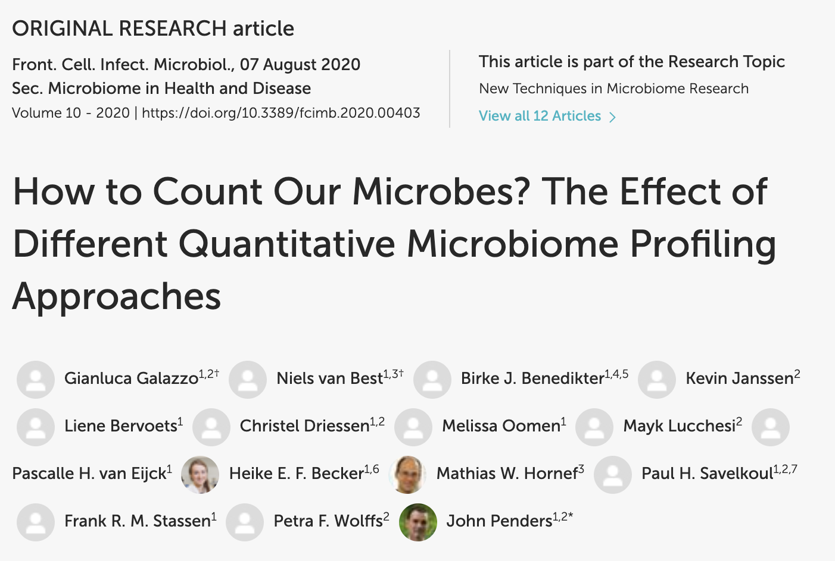
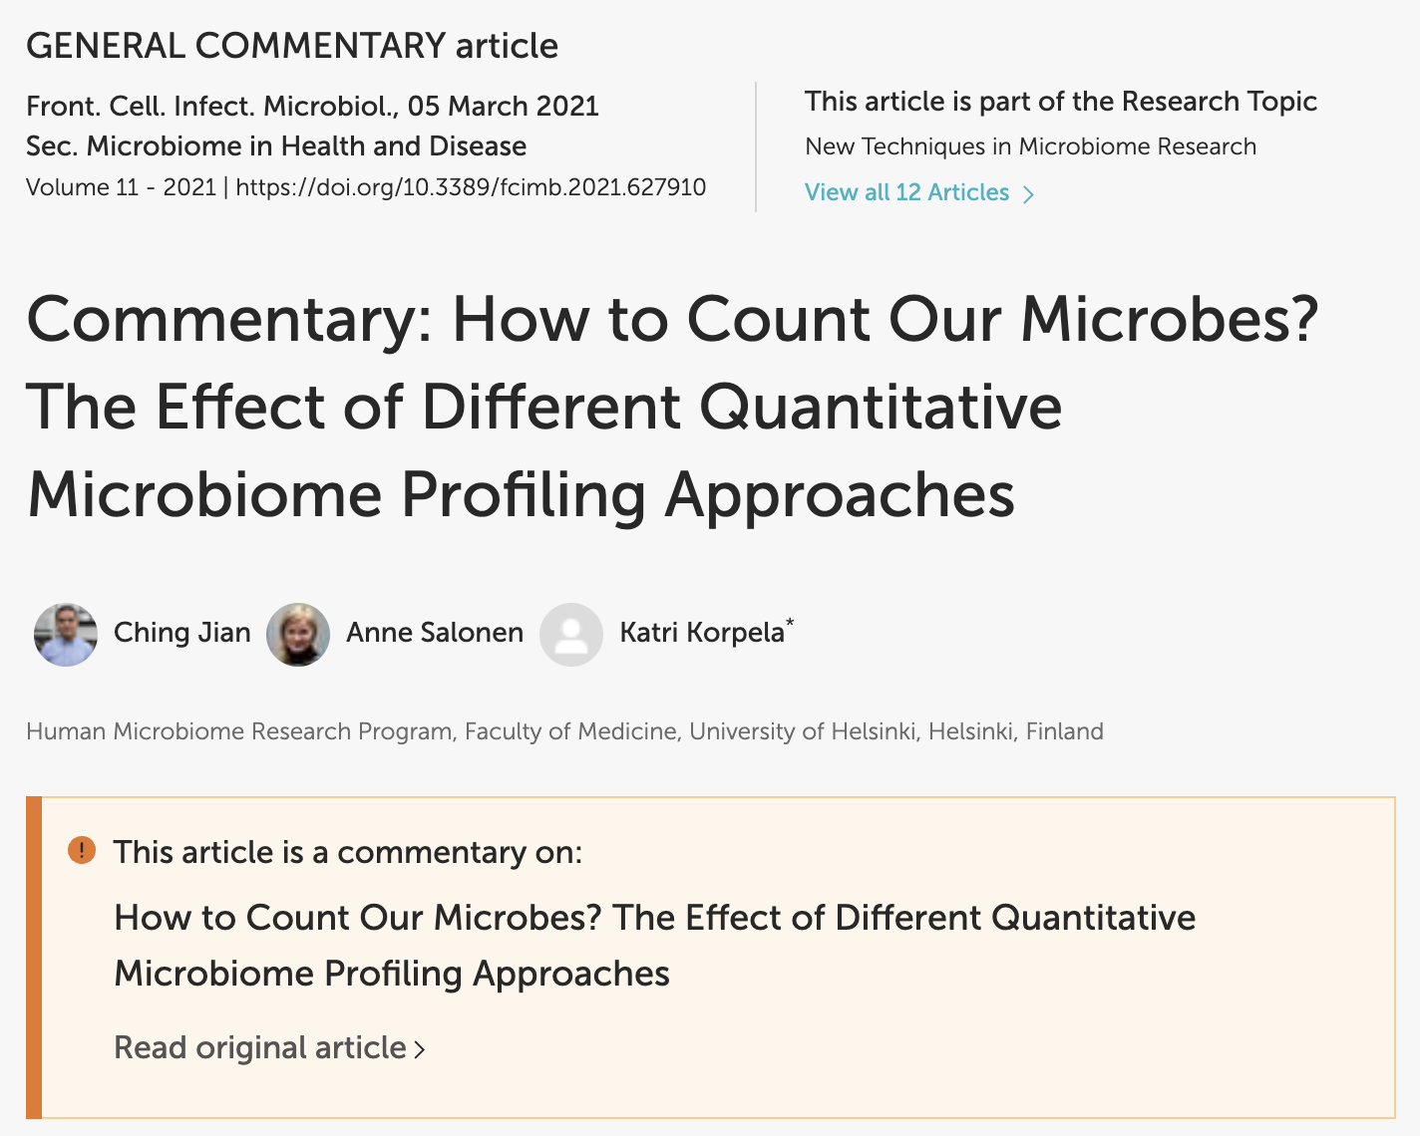
There’s a lot of literature on this, and no perfect (or even great? ) method

Slide 6
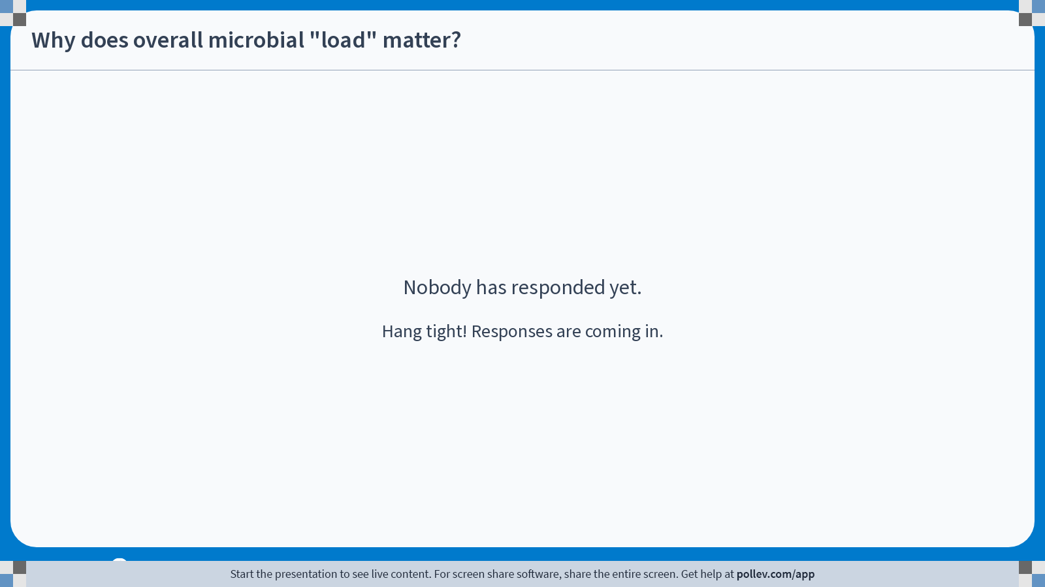
Notes:
Do not modify the notes in this section to avoid tampering with the Poll Everywhere activity. More info at polleverywhere.com/support Why does overall microbial "load" matter?
https://www.polleverywhere.com/free_text_polls/SipPg4iv4cySi3VZcg3Eu

Slide 7
You really need to know if your samples fall into either of these categories:
low microbial biomass
very high microbial biomass, and high diversity

Slide 8
Topic #2: Sequencing depth

Slide 9
The sequencing process inevitably results in uneven ”effort” across samples:
# of Reads
Samples

Slide 10
This can be systematic by sample type/matrix…resulting in measurement bias
# of Reads
Feces
Soil
Sponge
Trim
Water

Slide 11
Therefore, we need some way to account for this in our analysis

Slide 12
One way to do this is to rarefy (N.B., This is different from rarefaction)
To rarefy is to randomly “downsample” every sample to a level even with the sample with the lowest number of reads….

Slide 13
Visually…
# of Reads
Level of Rarefying
Samples

Slide 14
Obviously, this can result in loss of LOTS of data…
# of Reads
Level of Rarefying
Samples

Slide 15
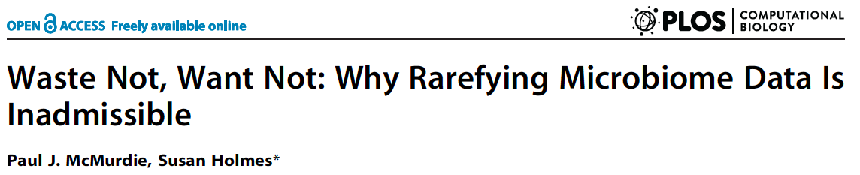
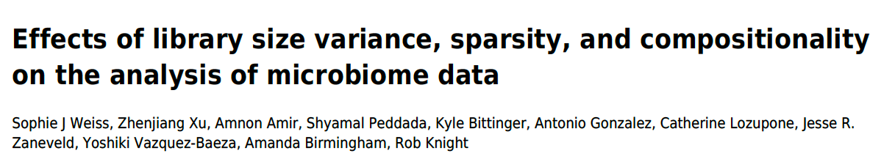


There is a lot of debate in the literature about the benefits vs. drawbacks of rarefying…

Slide 16
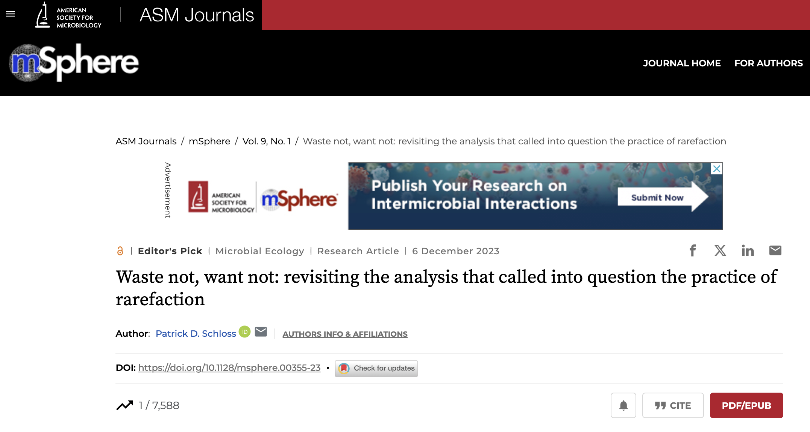

Very recently

Slide 17
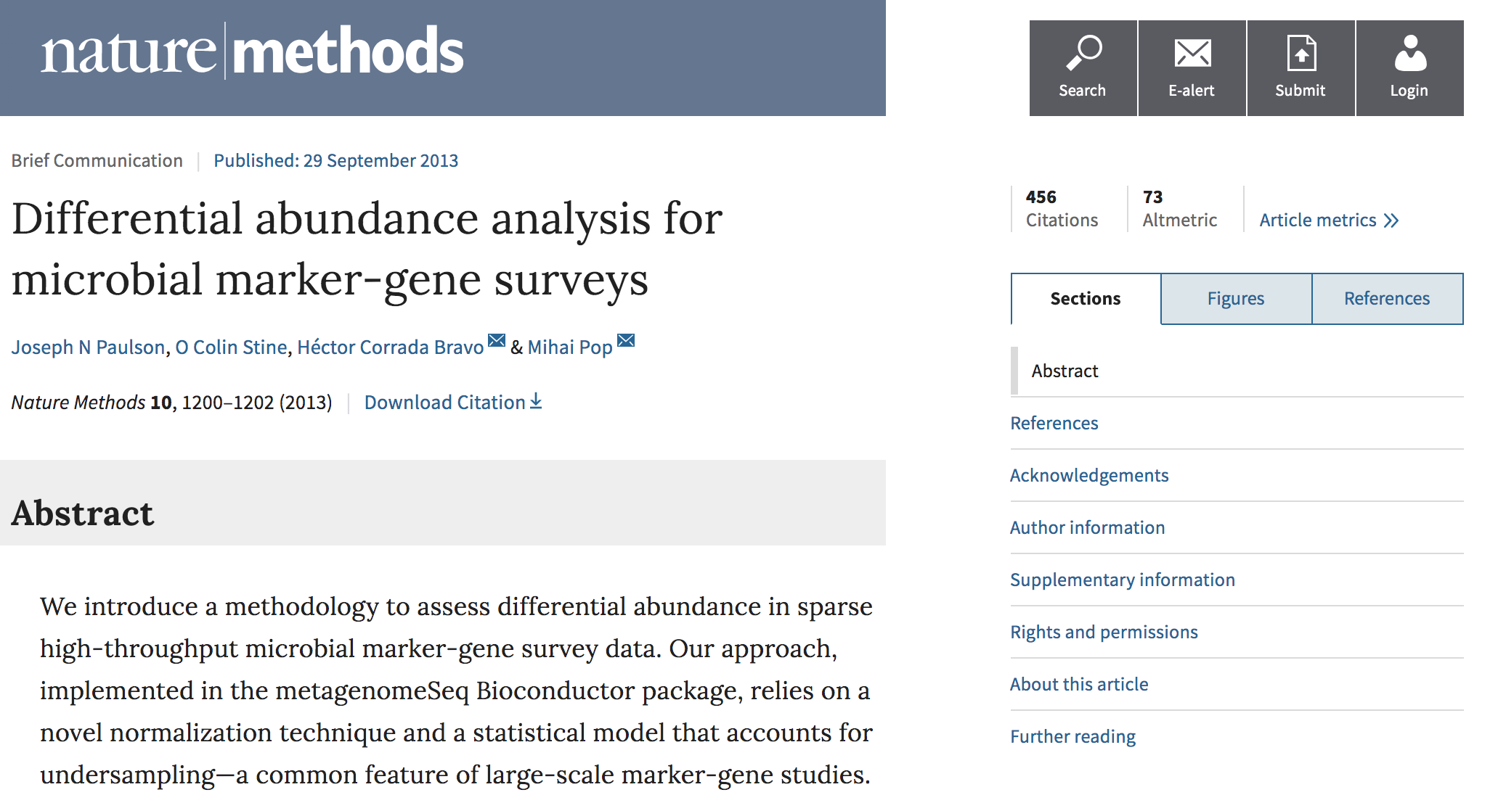
We will use CSS for our analyses today

Slide 18
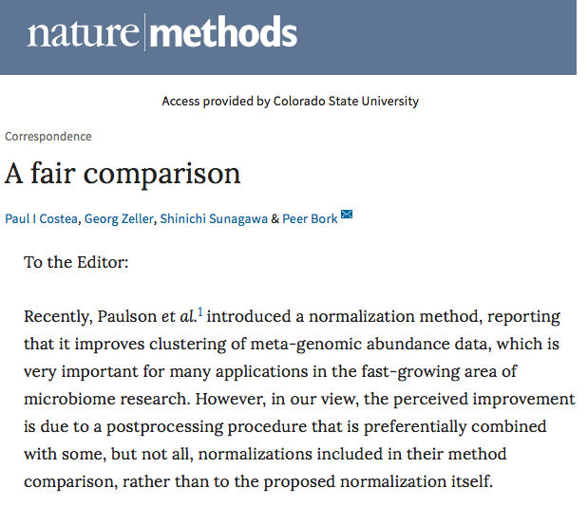
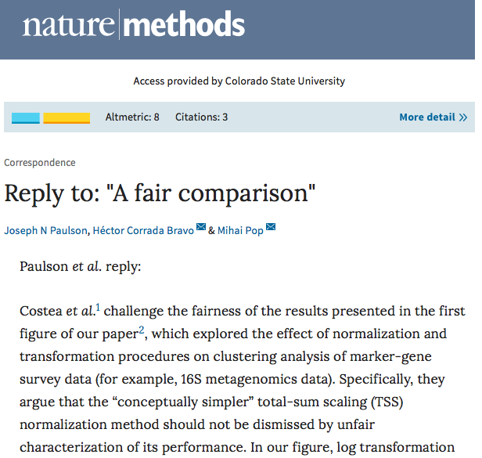
To be “fair”, this paper has also been under debate:

Slide 19
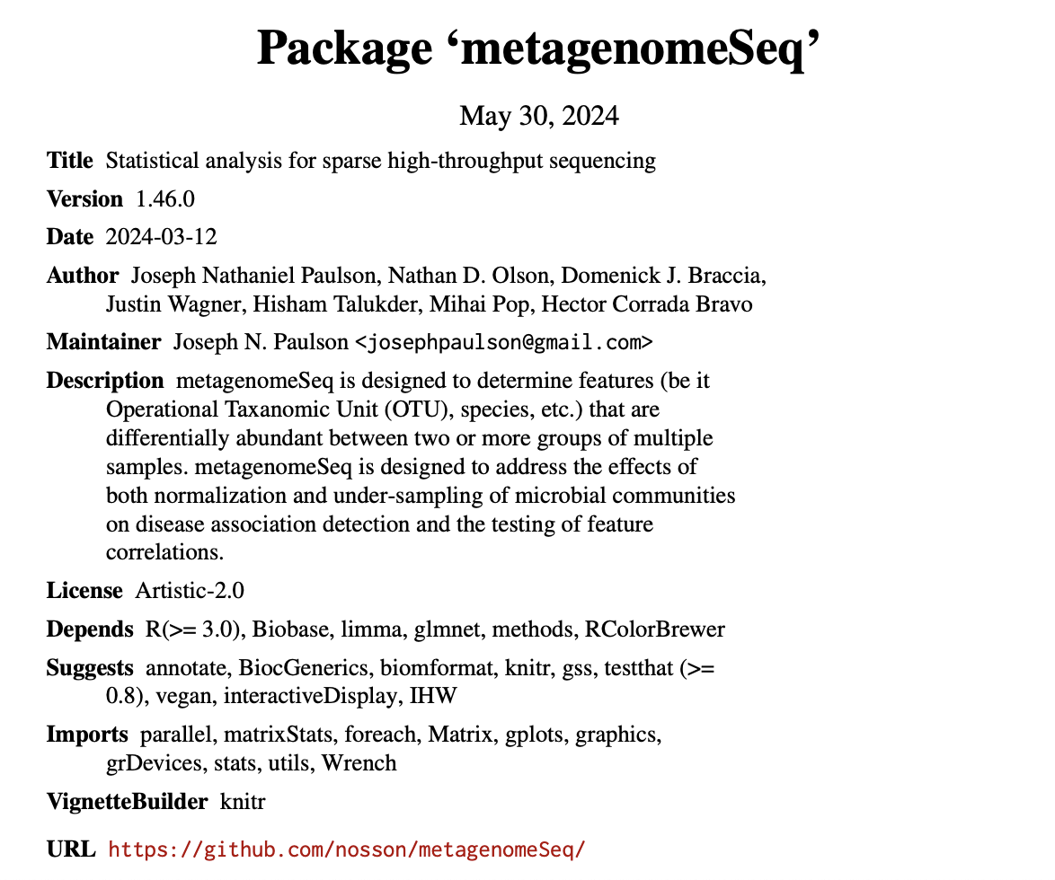
This approach is available in an R package called “metagenomeSeq”:

Slide 20
Topic #3: Positive controls
(Did I sequence what I expected to sequence?)

Slide 21
Different types of positive controls
https://zymoresearch.eu/collections/zymobiomics-microbial-community-standards

Slide 22
How can we use them?
Analysis of the positive control spike-in sample against the complete SILVA database showed Truepera as the most abundant genus with 51% of all reads, and Imtechella as the third-most abundant with 8.5% of reads. The genus Allobacillus was not identified, but the SILVA database only contains one reference for Allobacillus halotolerans. Therefore, we also aligned the sequences from the mock community to a custom database provided by ZymoBIOMICS (see “Methods” section), which resulted in detection of all three expected taxa, with Truepera radiovictrix comprising 33.8% of reads, Imtichella halotolerans 60.3%, and Allobacillus halotolerans 5.9%.

Slide 23
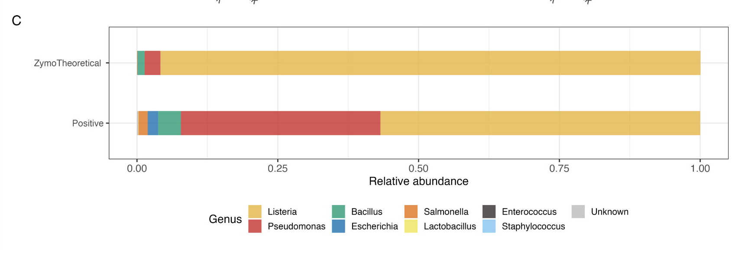
Did you get back what you put in? (**You most likely won’t, and do you actually know what you put in?)

Slide 24
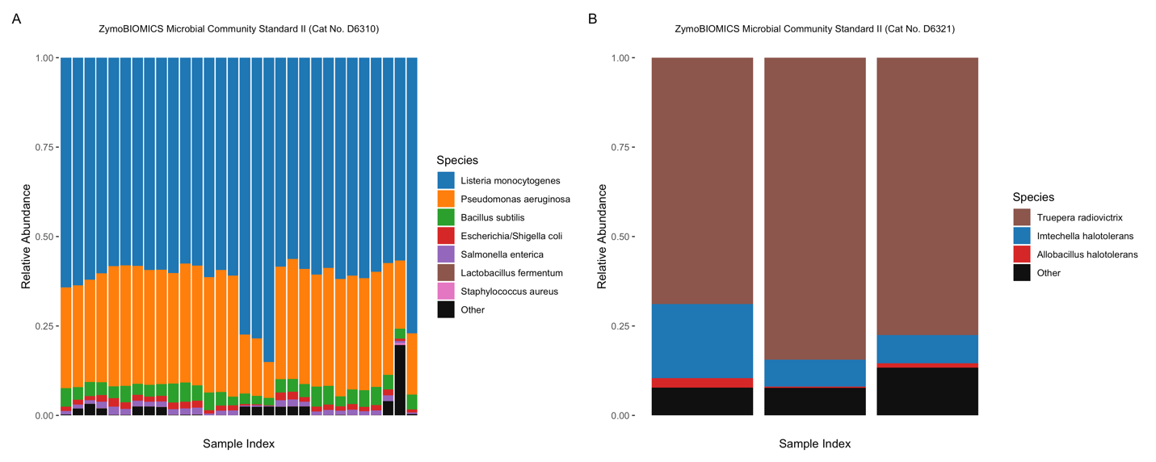
Consistency across extraction batches:

Slide 25
Topic #4: Negative controls
(How much contamination is in my data?)

Slide 26
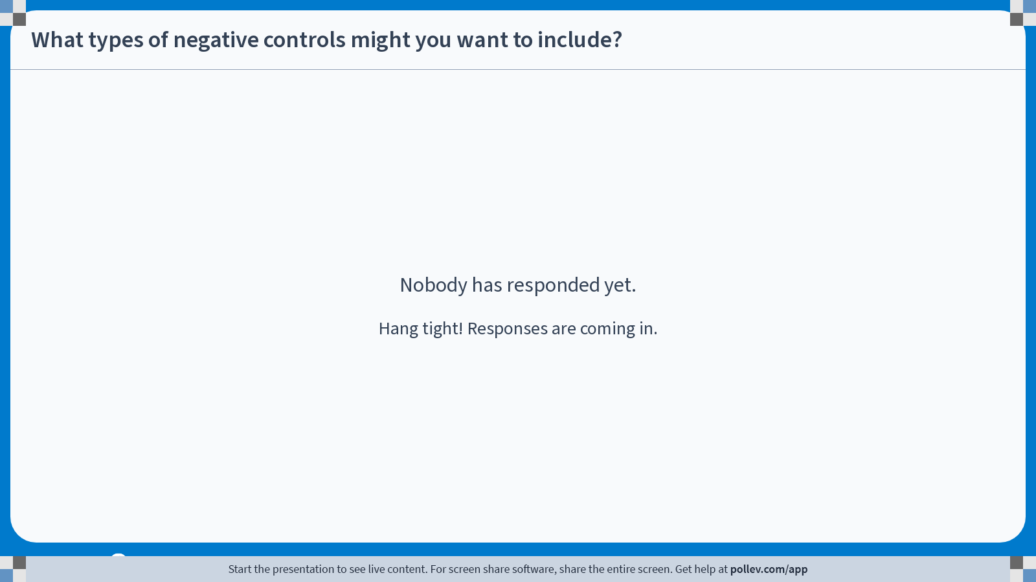
Notes:
Do not modify the notes in this section to avoid tampering with the Poll Everywhere activity. More info at polleverywhere.com/support What types of negative controls might you want to include?
https://www.polleverywhere.com/free_text_polls/mUL6UcCYn02JlK7GgL6zC

Slide 27
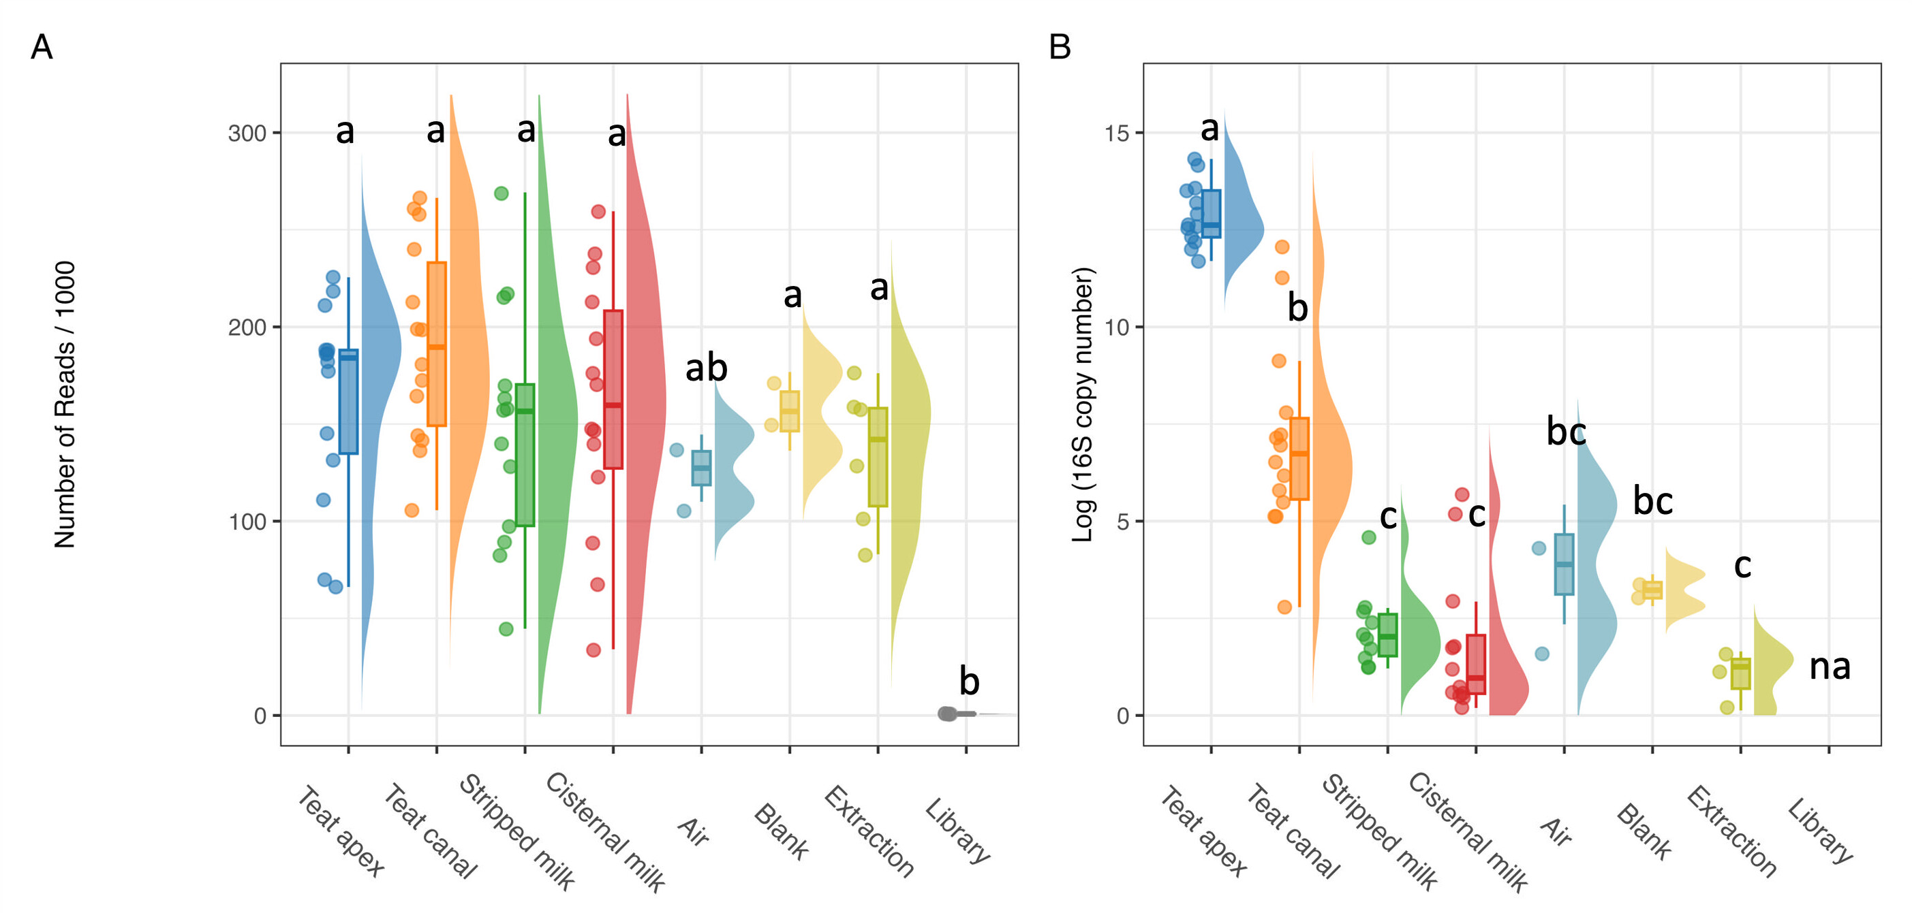
An example:
Dean CJ, Deng Y, Wehri TC, Pena-Mosca F, Ray T, Crooker BA, Godden SM, Caixeta LS, Noyes NR. 0. The impact of kit, environment, and sampling contamination on the observed microbiome of bovine milk. mSystems 0:e01158-23.https://doi.org/10.1128/msystems.01158-23

Slide 28
What can you do with the negative controls?
Describe them
--and/or—
Use them to identify and remove likely contaminant sequences in your real samples (decontam)

Slide 29
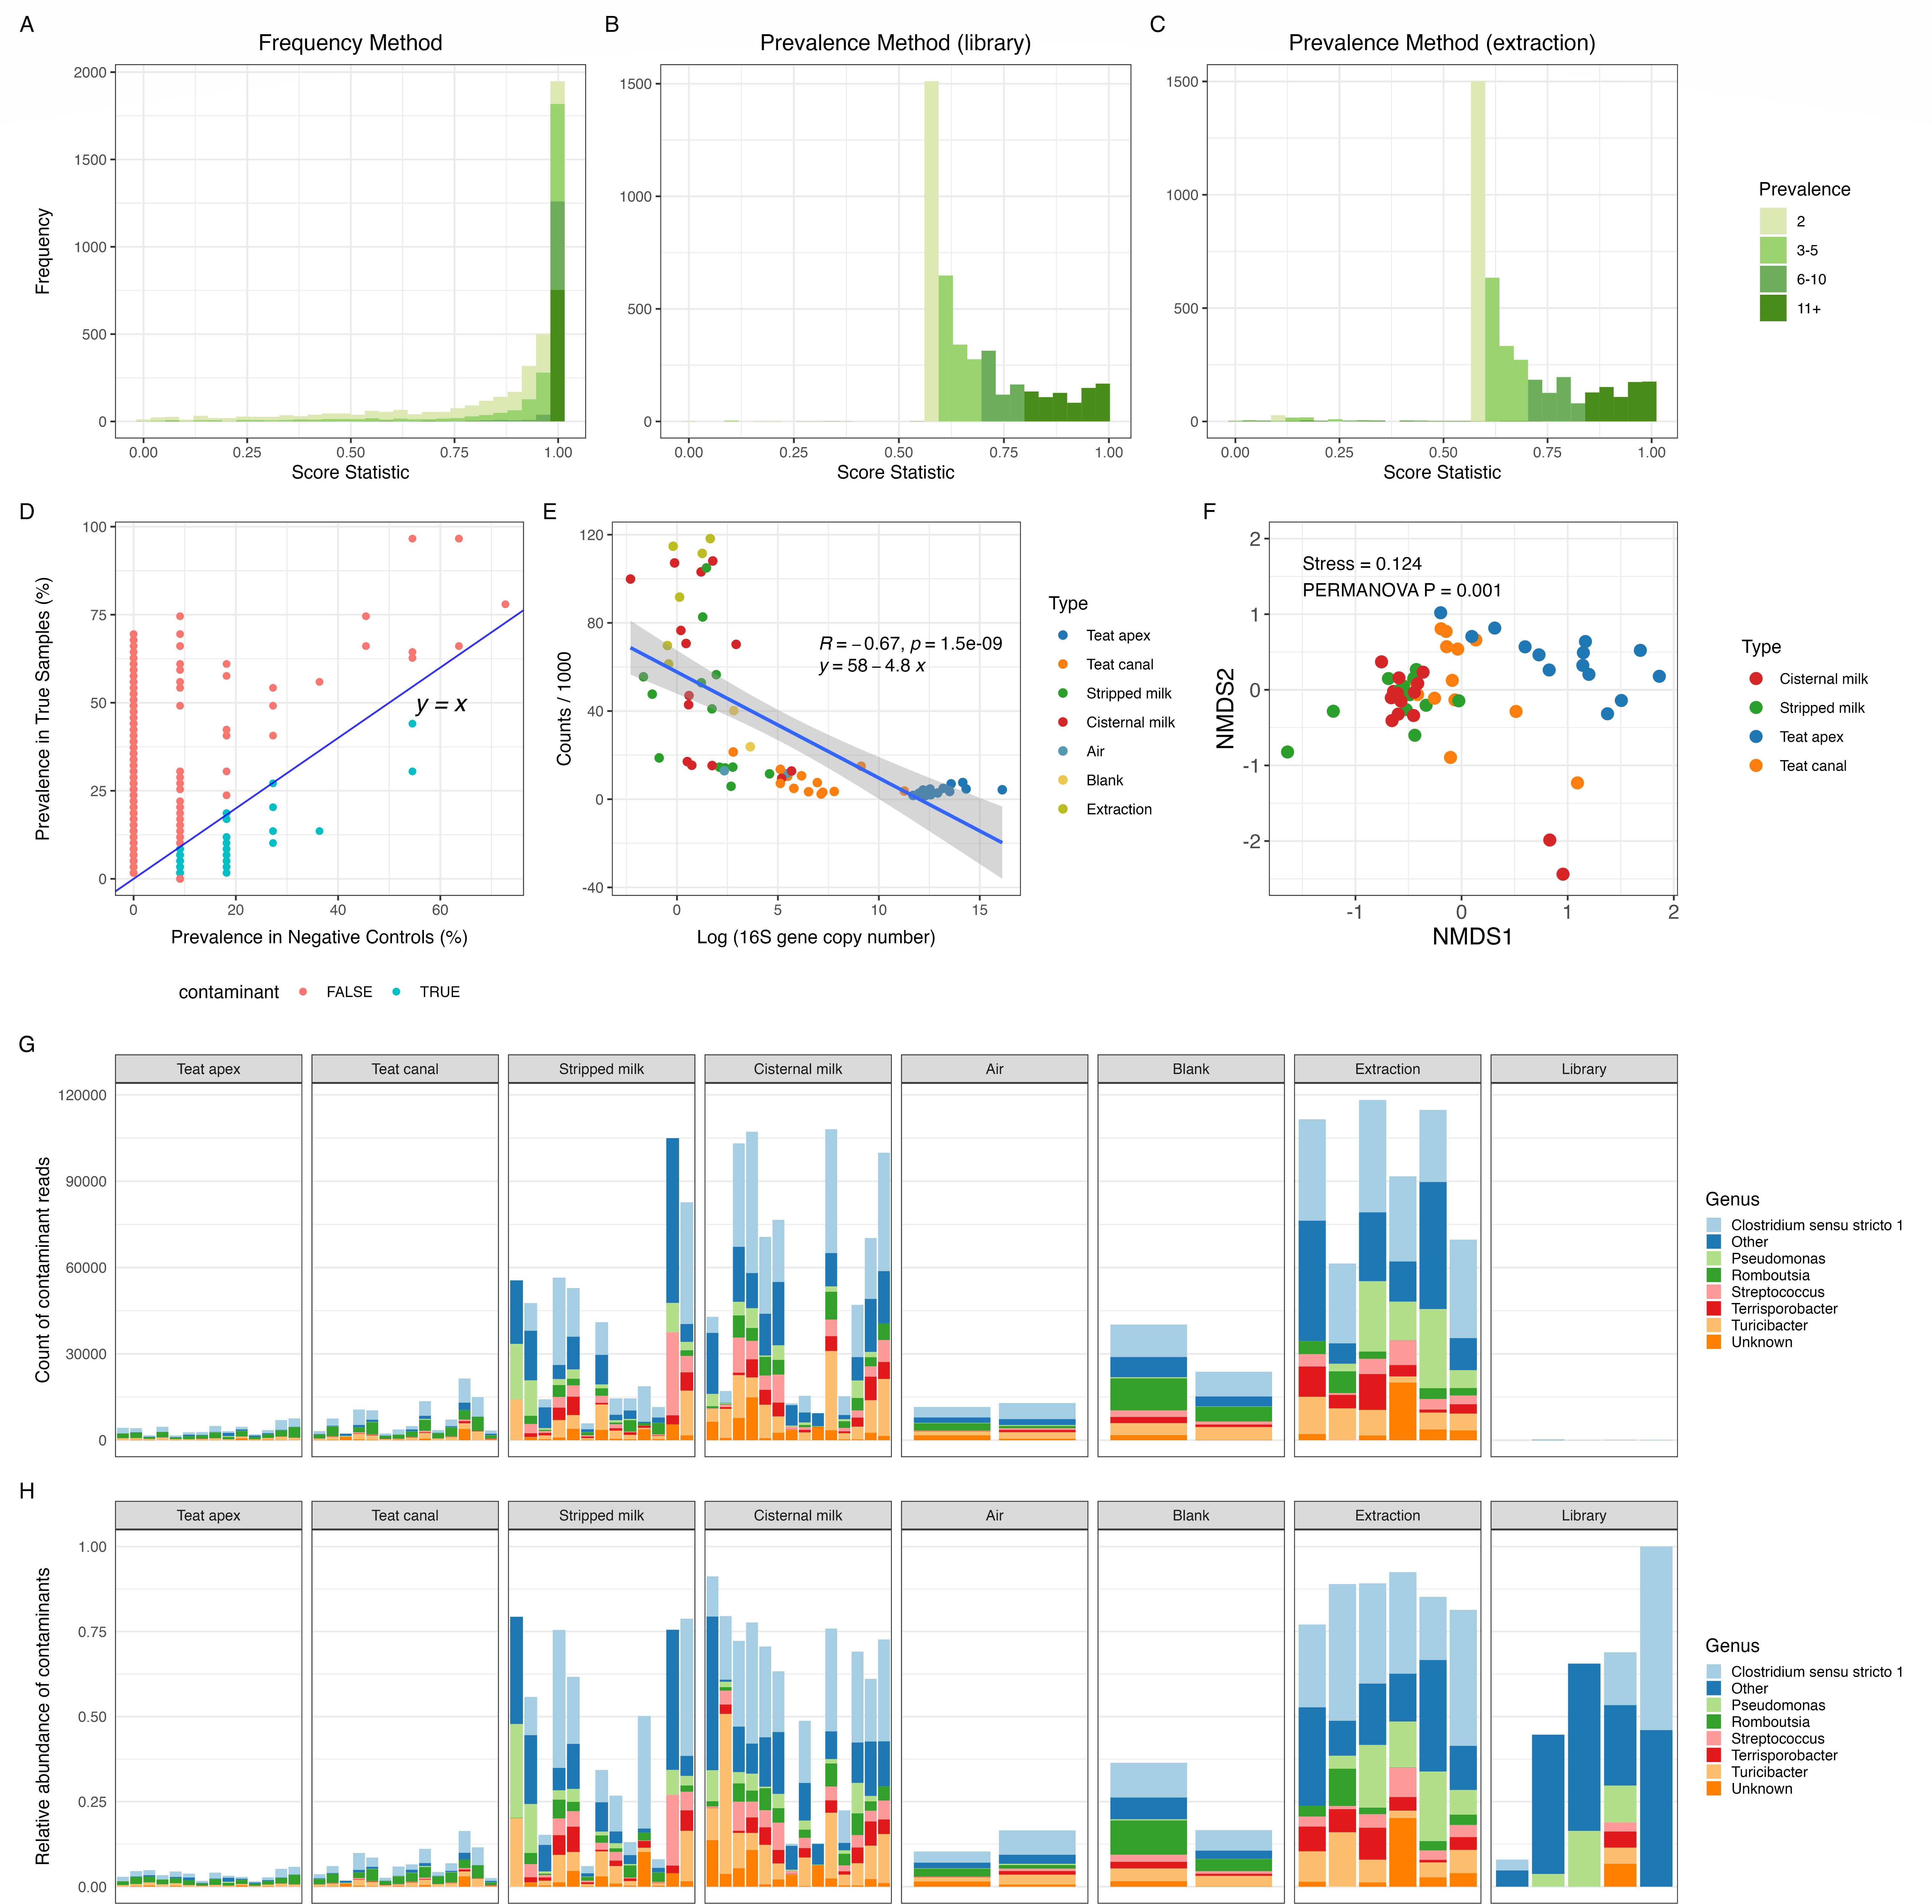
Describe:
Dean CJ, Deng Y, Wehri TC, Pena-Mosca F, Ray T, Crooker BA, Godden SM, Caixeta LS, Noyes NR. 0. The impact of kit, environment, and sampling contamination on the observed microbiome of bovine milk. mSystems 0:e01158-23.https://doi.org/10.1128/msystems.01158-23

Slide 30
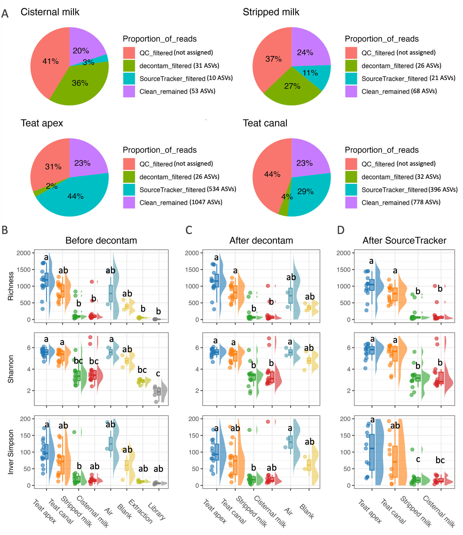
Use to Remove:
Dean CJ, Deng Y, Wehri TC, Pena-Mosca F, Ray T, Crooker BA, Godden SM, Caixeta LS, Noyes NR. 0. The impact of kit, environment, and sampling contamination on the observed microbiome of bovine milk. mSystems 0:e01158-23.https://doi.org/10.1128/msystems.01158-23

Slide 31
Topic #5: Batch Effects
(What technical factors might confound my analysis?)

Slide 32
Let’s start with a science story

Slide 33
Poultry litter is important in poultry production
Important in establishing the microbiome of newly placed chicks
Typically reused over multiple flock cycles

Slide 34
Study goal:
To assess temporal changes in the microbiome of reused litter over multiple broiler flock cycles.

Slide 35
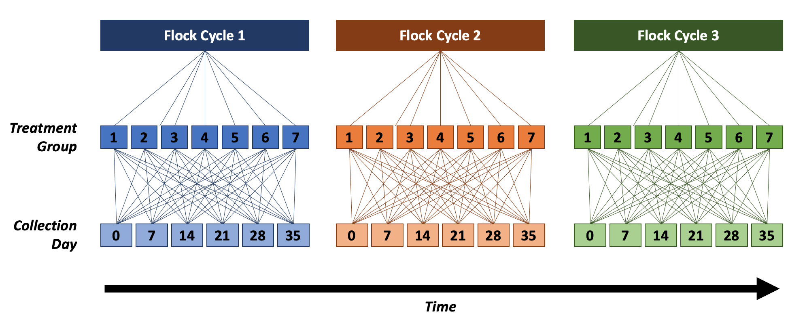
Study Design:
Collection Day

Slide 36
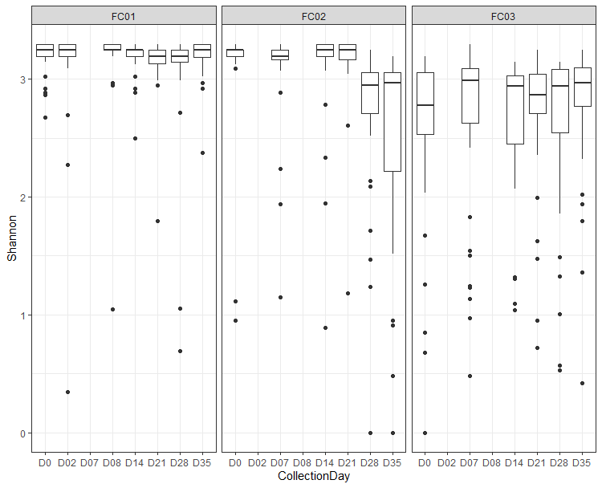
Something seems to happen at Day 28 in Flock 2…any ideas?

Slide 37
These samples were sequenced in 2 batches

Slide 38
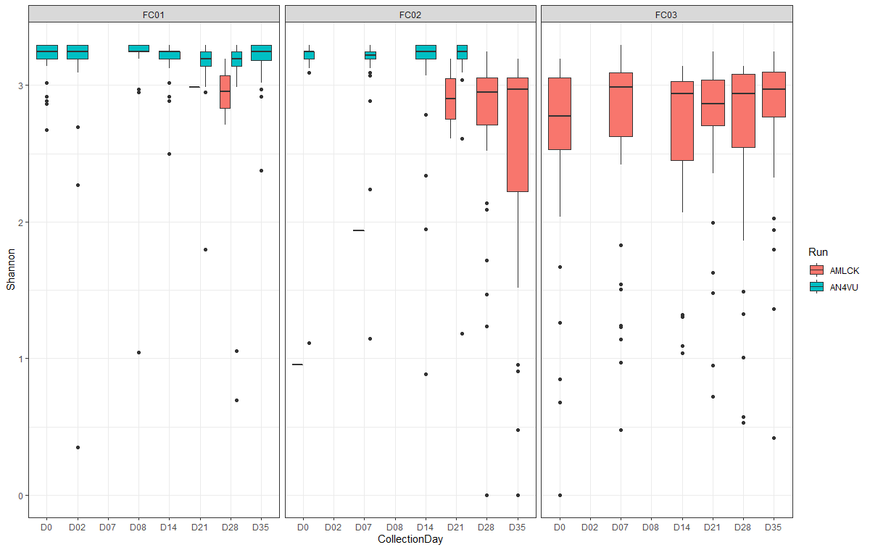
Same chart, but shown by sequencing batch:

Slide 39
Discussion: How do you avoid this??

Slide 40
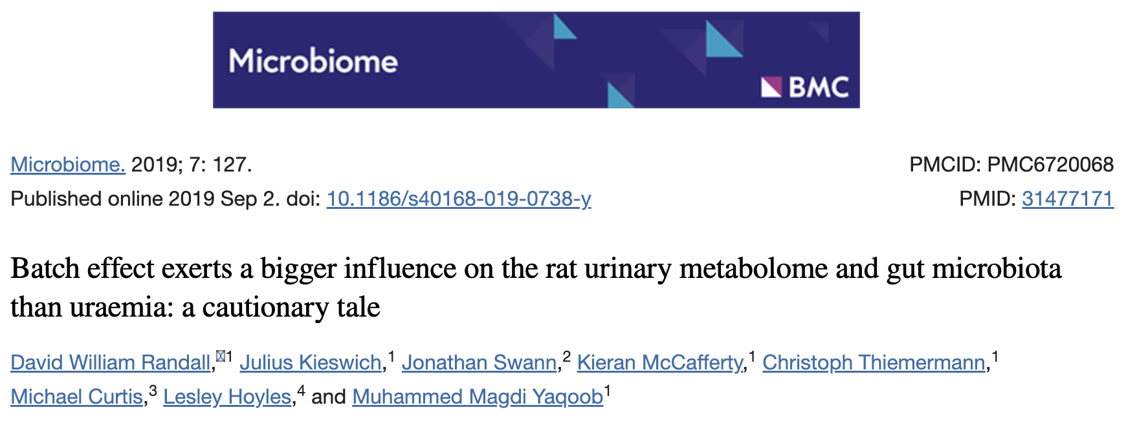
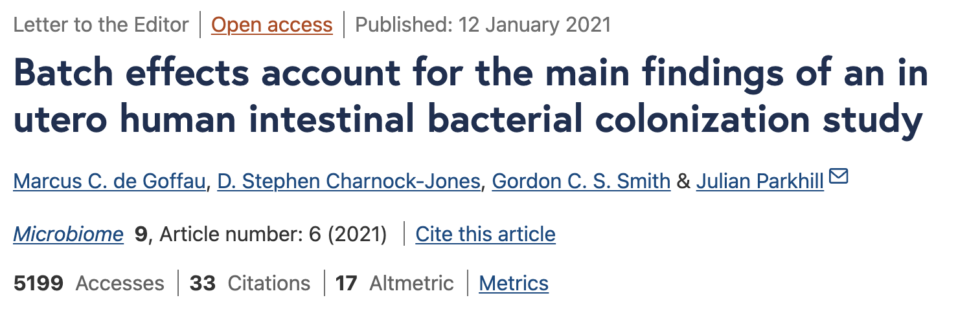
Other sources of batch effect?

Slide 41
Questions?

Slide 42
To produce normalized counts:
~
normalized counts
c_{ij} = (c_{ij}/s^{l}_{j})(N)
where
c_{ij} = counts for feature i in sample j
s^{l}_{j =} sum of counts for sample j up to the lth quantile
N = normalization constant

Slide 43
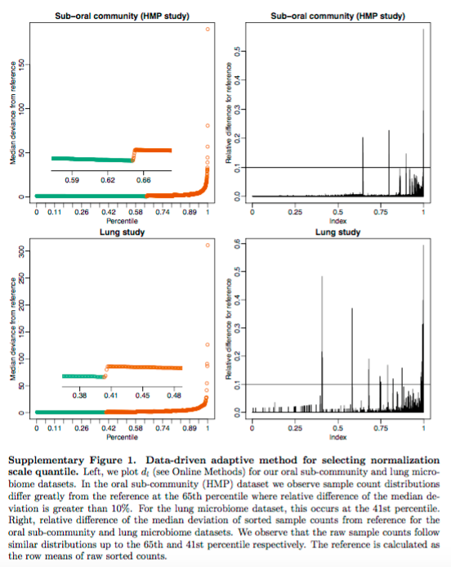
“l” is determined using a data-driven approach
“N” is recommended to be chosen as the median s^{l}_{j} across all samples
For more detail, see the supplemental M&M for the paper

